Slide 1
ENG4118/5326 - Robotics 4/M Sensors, Actuators and Image capture, processing and analysis
Lecture 5
Kevin Worrall

Slide 2

Overview
Potentiometers
LVDT
Resolvers
Draw Strings
Review

Slide 3
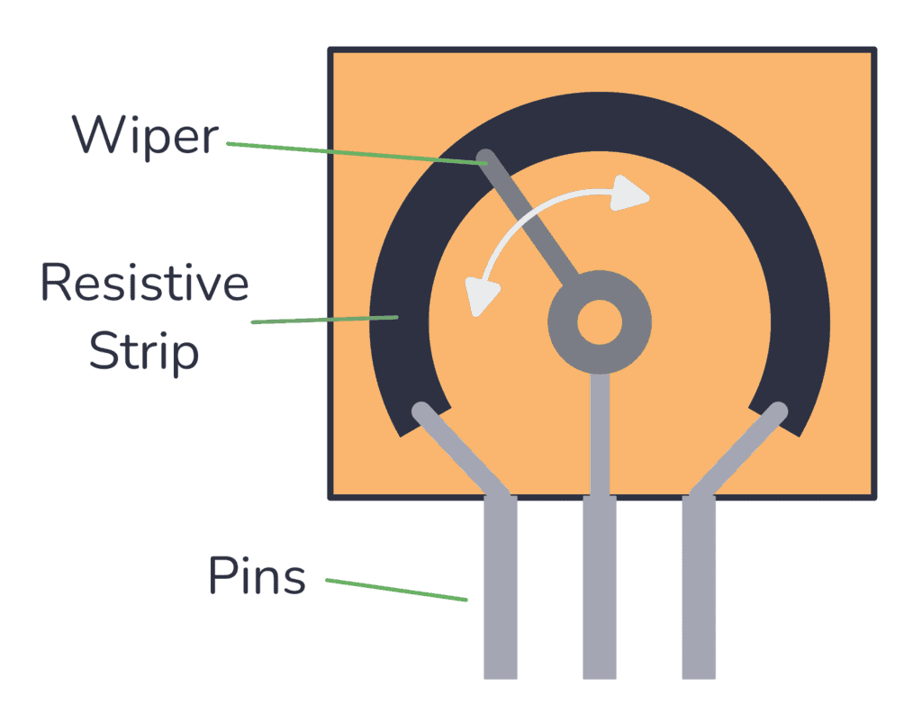
Potentiometers
Potentiometers are available in both linear and rotary forms and can be used to measure linear or angular motion
The resistor is in the form of a track along the potentiometer
This track may be of thin film of a resistive material such as carbon, conductive ceramic, conductive plastic or metal
Alternatively wire wound potentiometers are used with the track consisting of a highly resistive wire wound on to anodised aluminium
https://www.build-electronic-circuits.com/potentiometer/

Slide 4
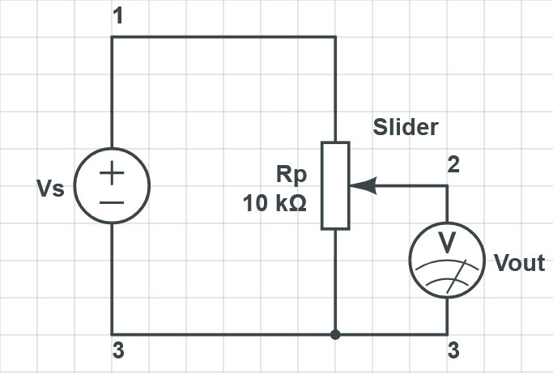
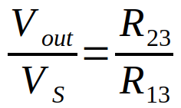
Potentiometers
Input voltage, Vs, is between terminals 1 and 3
Output voltage is between terminals 2 and 3.
With a constant input voltage, V_{S}, the output voltage, V_{out}, is a fraction of the input voltage

Slide 5
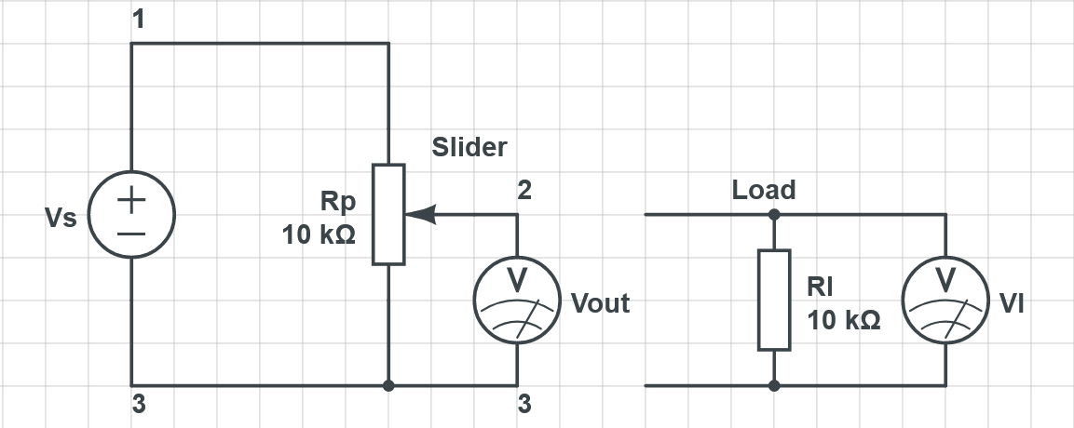
Potentiometers
An important effect to be considered with potentiometers is the effect of load, Rl, connected across the output.

Slide 6
Potentiometers
The potential difference across the load, Vl, is only directly proportional to the output voltage, Vout, if the load resistance, Rl, is infinite
For loads of finite resistance, the effect of the load is to transform the linear relationship between voltage and displacement into a non-linear relationship
To find the total resistance across the input voltage we analyse the circuit

Slide 7

Potentiometers
Full Calculation is:
$$\frac{Vl}{Vs}=\frac{x}{\frac{Rp}{Rl}.x.\left(1−x\right)+1}$$
With x being a fraction of Rp
However…

Slide 8

Potentiometers
Error introduced by load having finite resistance is:
$$error=x.Vs−Vl=x.Vs−\frac{x.Vs}{\frac{Rp}{Rl}.x.\left(1−x\right)+1}=Vs.\frac{Rp}{Rl}.\left(x^{2}−x^{3}\right)$$

Slide 9

Potentiometers - Error
Example - 500Ω with slider 1/2 along the track, Rl 10kΩ, Vs 4V
$$error=Vs.\frac{Rp}{Rl}.\left(x^{2}−x^{3}\right)=4×\frac{500}{10000}×\left({0.5}^{2}−{0.5}^{3}\right)=0.025V$$
As a percentage of fullscale input range this 0.625% (0.025/4 * 100)
Example - 500Ω with slider 1/2 along the track, Rl 50kΩ, Vs 4V
$$error=Vs.\frac{Rp}{Rl}.\left(x^{2}−x^{3}\right)=4×\frac{500}{50000}×\left({0.5}^{2}−{0.5}^{3}\right)=0.005V$$
As a percentage of fullscale input range this 0.125% (0.005/4 * 100)
This shows the difference Rl can make.

Slide 10
Potentiometers
Problems with wiper wear are significant and result from the friction between the wiper and track
Reliability improved by minimising current drawn from wiper contact
Provide absolute position information at relatively low cost (unless very high accuracy needed)

Slide 11
Linear Variable Differential Transformer

Slide 12
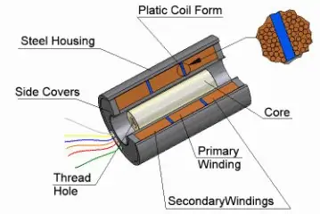
Linear Variable Differential Transformer
LVDT for short
Widely used as primary sensors for monitoring displacements
Consists of three coils symmetrically spaced along an insulated tube.
The central coil is the primary coil and the other two are identical secondary coils which are connected such that their outputs oppose each other.
Measurements made through the movement of a magnetic core which results from the displacement of the probe tip.
https://singer-instruments.com/introduction-to-lvdt/

Slide 13
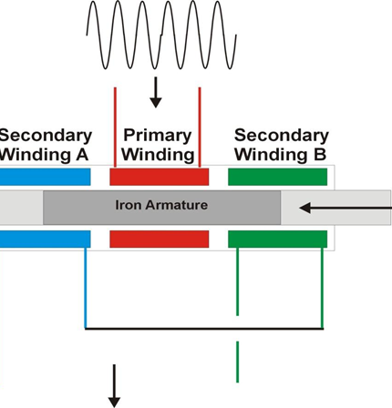
Linear Variable Differential Transformer
When an alternating voltage input is applied to the primary coil, alternating emf′s are induced in the secondary coils
With the magnetic core central, the amount of magnetic material within each of the secondary coils is equal and the emf′s produced in each coil are the same with the net result being zero output
When the core is displaced from the central position, due to probe displacement, there is a greater amount of the core in one of the secondary coils than the other
This results in a greater emf being induced in one coil than the other which produces a non-zero output
The sensor output, the difference between the two emf’s increases with increased displacement
Or… https://www.youtube.com/watch?v=08yKYiZv-kg

Slide 14

Linear Variable Differential Transformer
The emf induced in a secondary coil by a changing current i in the primary coil is given by:
$$emf=M.\frac{di}{dt}$$
M is the mutual inductance which is dependent on the number of turns on the coils and the composition of the core
For a sinusoidal input current of i = isinωt to the primary coil, the emf’s induced in the two secondary coils are:
$$Va=Ka.\sin\left(ω.t−ψ\right) Vb=Kb.\sin\left(ω.t−ψ\right)$$

Slide 15

Linear Variable Differential Transformer
The values of kA, kB and φ depend on the degree of coupling between the primary and secondary coils for a particular core position
φ is the phase difference between the primary alternating voltage and that of the secondary coils
The LVDT is the difference between the two secondary coils given by:
$$Vout=Va−Vb=\left(ka−kb\right).\sin\left(ω.t−ψ\right)$$
When the core is equally in both coils ka = kb and the output voltage is zero

Slide 16

Linear Variable Differential Transformer
When the core is more in secondary coil a than in b we have ka > kb :
$$Vout=\left(ka−kb\right).\sin\left(ω.t−ψ\right)$$
When the core is more in secondary coil b than in a we have ka < kb and there is a phase change of 180:
$$Vout=−\left(ka−kb\right).\sin\left(ω.t−φ\right)$$
or
$$Vout=\left(kb−ka\right).\sin{(ω.t+(ψ−φ\text{))}}$$
The output voltage and phase for varying displacements are shown for the secondary coils in the following slide

Slide 17
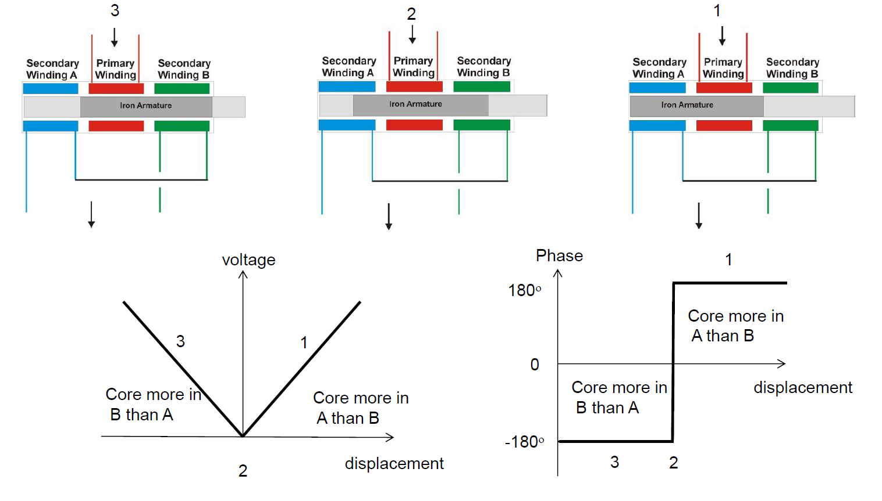
Linear Variable Differential Transformer

Slide 18
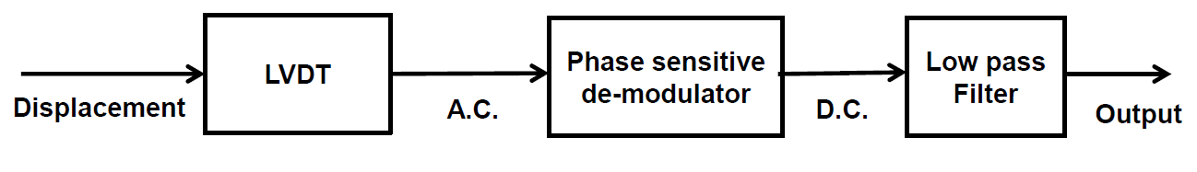
Linear Variable Differential Transformer
With this type of output the same output voltage amplitude is produced for two different displacements
To distinguish between displacements, we need to distinguish them using the phase of their output voltage
A phase sensitive demodulator, with a low pass filter, is used to convert the output into d.c. voltage which gives a unique value for each displacement

Slide 19
Linear Variable Differential Transformer
LVDTs are rugged devices compared to potentiometers and can be used as secondary sensors for the measurement of Force, Weight or Pressure.
They have operating ranges between ±2 to ±400mm with non-linearity errors of around ±0.25%
They are also very accurate, with accuracies from 0.5% to 0.05% typically, but require external support circuitry
Resolution limited by presence of the null voltage (exact cancellation of secondary voltages not possible due to different phase shifts in the two windings).

Slide 20
Resolver

Slide 21
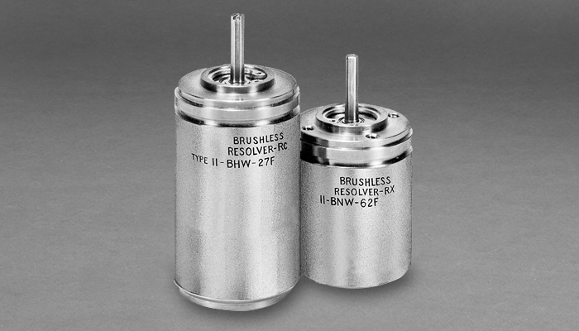
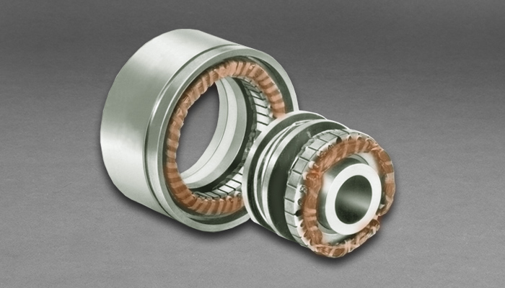
Resolvers
Resolvers are like LVDTs in principle but are used to measure angular motion
A resolver is also a transformer where the primary coil is attached to the rotating shaft and carries an alternating current, either through slip rings or from a brush-less transformer within it
There are two secondary coils positioned 90° apart from each other
As the rotor rotates the flux it develops rotates with it

Slide 22
Resolvers
When the primary coil is parallel to either of the secondary coils the voltage induced in the coils is maximum

Slide 23
Resolvers
At this instant the primary coil is perpendicular to the other secondary coil and no voltage is developed within it
As the primary coil rotates the voltage in the first secondary coil goes to zero whilst the voltage of the other secondary coil becomes maximum
For all angles in between the two secondary coils develop a voltage proportional to the sine and cosine of the angle between the primary and secondary coils
Resolvers are reliable, robust and accurate
Accuracy more dependant on the sensing circuitary
However, resolvers are significantly more expensive than potentiometers
High speeds up to 20000RPM

Slide 24
Draw String

Slide 25
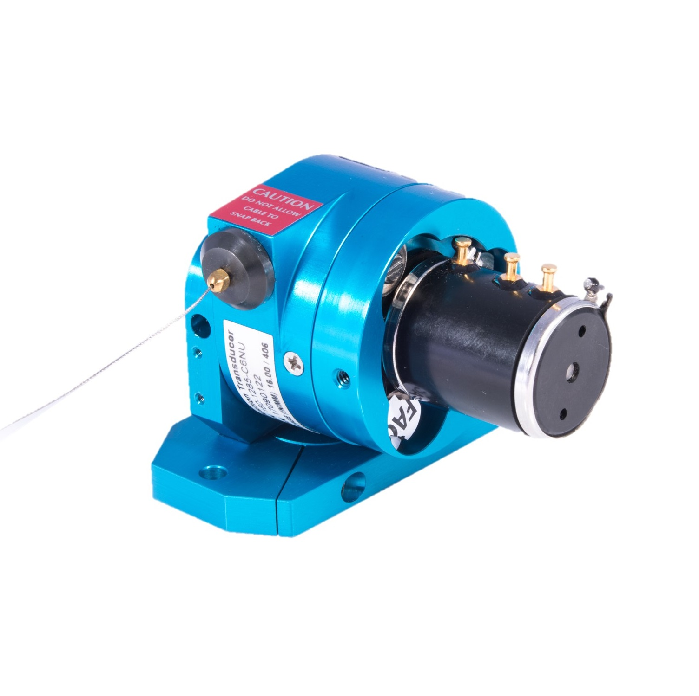
Draw Strings (String Pots)
Simple concept for measuring linear position
A thin cable is spooled out
This spooling rotates a potentiometer or encoder
Translates into a resistance or digital count
Easy to use
Easy to install
Easy to interface to
Various lengths available from 0.05 to > 50m
Linearity, error, and resolution dependent on length

Slide 26
Review
Overview
Potentiometers
LVDT
Resolvers
Draw Strings

Slide 27
References
Bolton, W., Mechatronics, 5th Edition, Pearson, 2012
Chapter 2 - Sections 2.1 and 2.2
Niku, S.B. , Introduction to Robotics, 2nd Edition, Wiley, New Jersey, 2011.

